Slide 1

IBM Data Science
Capstone Project

Slide 2
Introduction
A customer is looking to open a Chinese restaurant in Downtown Toronto, but cannot decide on which neighbourhood is best suited for this. The objective of this project is to help this customer determine which neighbourhood has the best potential for starting a Chinese restaurant.

Slide 3
Data
The data required for this problem are:
Geo-data of Neighbourhood centers in Toronto (Latitude, Longitudes)
Food places in various neighbourhood in Toronto
Other venues in various neighbourhood in Toronto
Food places and other venues are searched for within 500m from the various neighbourhood centres in Toronto
The following data sources are to get the data required for this project
Wikipedia Page on Toronto Neighbourhoods
Pre-existing dataset to obtain Toronto Neighbourhood geo-location data (latitude and longitudes)
Foursquare API to obtain venue data

Slide 4
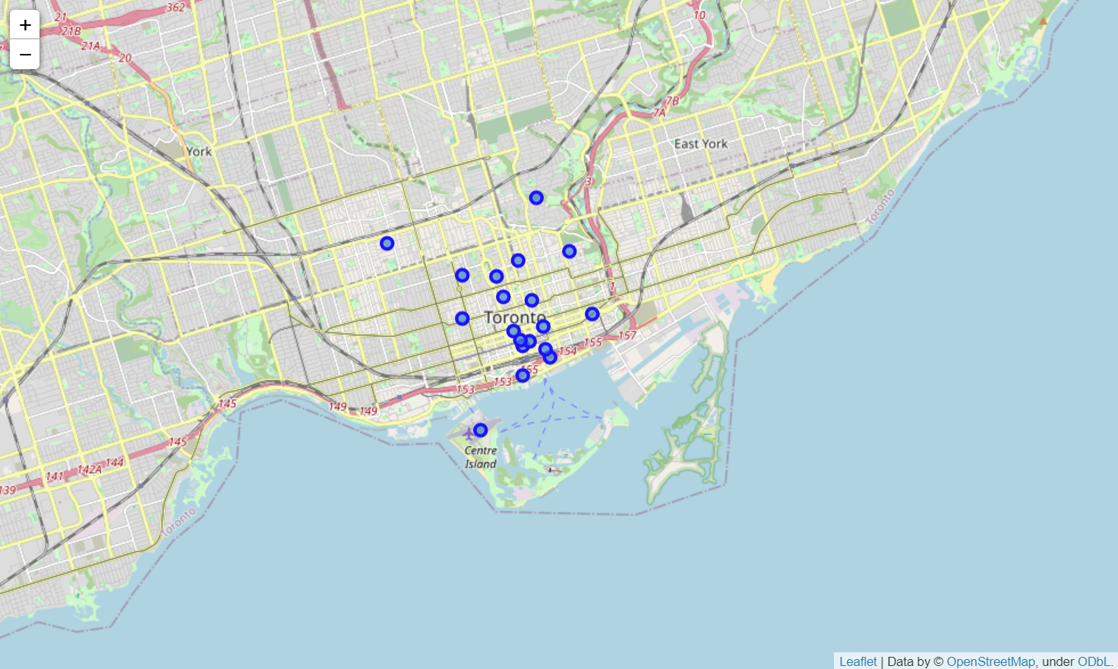
Methodology and Results
Exploratory Data Analysis
Initial Observations
Existence of airport, university as well as multiple parks
Near the coast

Slide 5
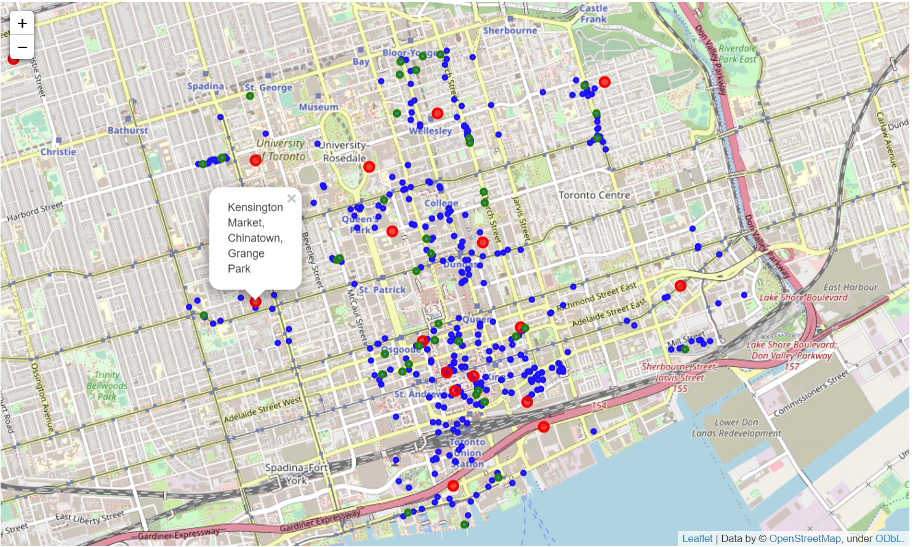
Methodology and Results
Exploratory Data Analysis
Further Analysis
Need to understand more about the restaurants locations (blue), as well as Asian restaurants locations (green).
Can be observed that restaurants usually form a cluster for locality effect. We want to ride on this effect, but also do not want to have too much competition with Asian restaurants in the vicinity
We observe that Kensington has a restaurant cluster, but only 1 Chinese food joint, which is a potential location for us to set up another Asian joint.

Slide 6
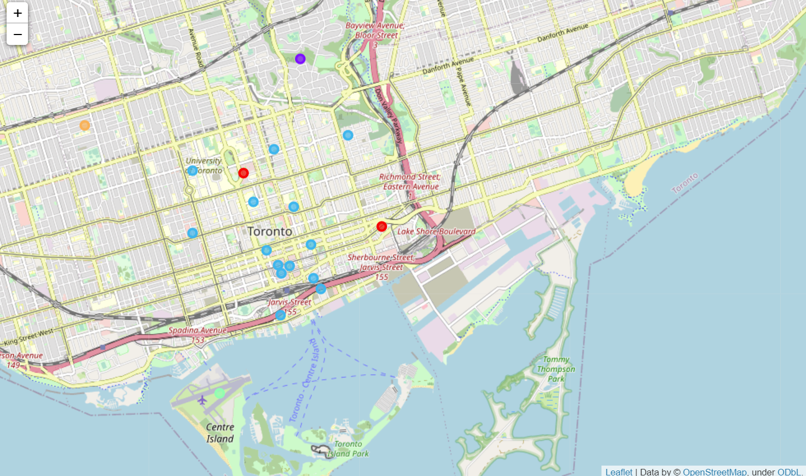
Machine Learning
K-clustering
We want to determine the similarity of the neighbourhoods to identify if it is suitable for an Asian restaurant.
Use of k-clustering to identify if the neighbourhoods are similar or belong to the same cluster based on the profile of the top 10 types of amenities
This gives us an insight into the lifestyle of the habitants in the area

Slide 7
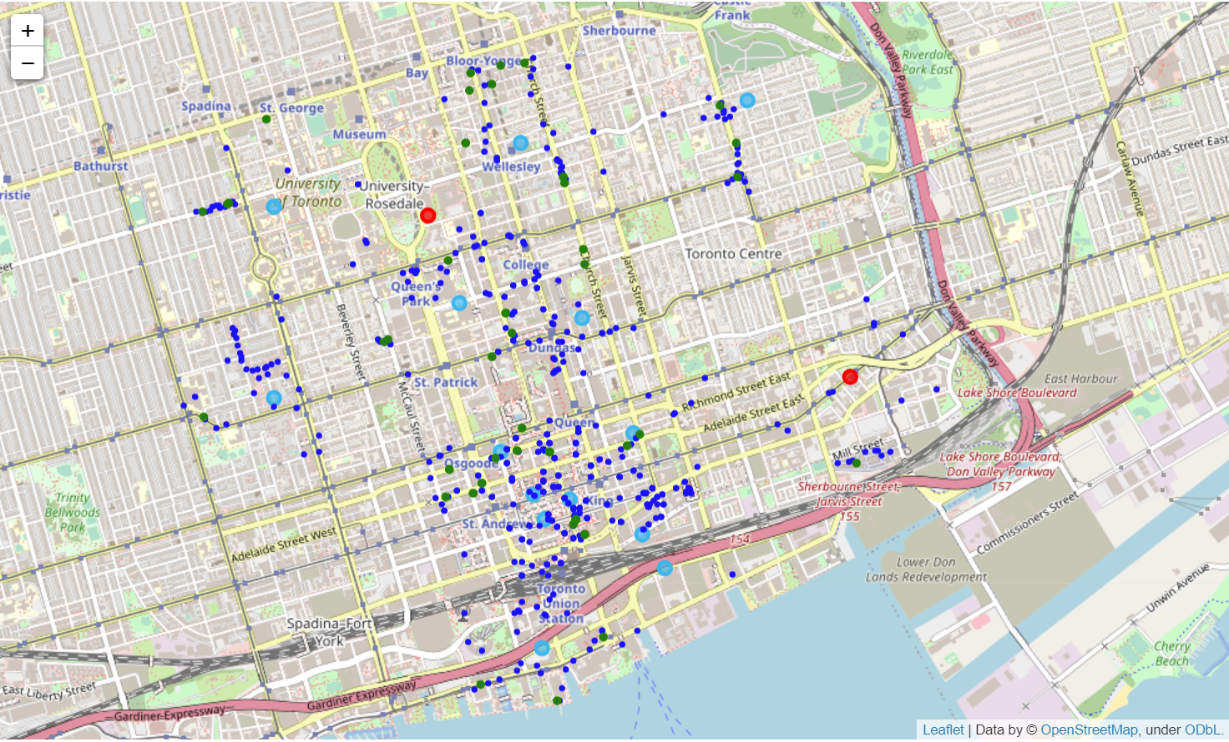
Machine Learning
K-clustering
We can observe the following about the Kensington Area (in black circle)
It belongs to the same cluster as neighbourhood such as the Richmond Area, where there is presence of many Asian/Chinese food joints
There also exists a food joint cluster where we can ride on for the locality effect.

Slide 8
Conclusion
Based on the observations made previously, we would recommend Kensington as the ideal location to set up a new Asian/ Chinese food joint.
Kensington exhibits similar profile in terms of amenities and facilities as areas such as Richmond which can be translated into similar lifestyle habits for its occupants.
There also exists a food joint cluster in the northern and eastern area of Kensington. We can leverage on the locality effect which draws crowd to the area.
Therefore, we would recommend setting up the food joint in the area circled in red, ideally near the blue dots (other restaurants) to make full use of the locality effect.

